Slide 1
Session 7 – Qualtrics Reproducibly Data Skills for Research Kellogg Research Support
August 17, 2023
Notes:
Welcome. We are so happy you’re here.
What you are about to hear next is about the closest you will get to a lecture in this workshop series. Most of the rest of this will be pretty interactive.
There will be discussions and you follow along with a demonstration, and maybe try to solve a few problems yourself.
But before we get into demonstrations of tools and how to apply them to your research work, I want to talk a bit about the reproducibility of that work you are about to start.
It is a very important topic, and I believe there are a few general principles that, if kept in mind, can help you quite a lot when you go to reproduce your work in the future.

Slide 2
Outline
Journal requirements
Transparency and Openness Promotion (TOP) and Open Science
How to practice open science
Automation for reproducibility with Qualtrics surveys
Demonstration

Slide 3
Why reproducibility?
Be kind to your future self
You will need it for publication!
Notes:
Today we're going to offer an overview of how to automate research with Qualtrics surveys for easy reproducibility.
Are you sold on why reproducibility is important yet? What are some good reasons to ensure reproducibility of your data?
Avoid the problem of trying to remember what you did!
Why would you use R instead of SPSS? -->Learn a programming language instead of SPSS, R code is more universal, free open-source software, and can apply to other analyses makes it easier for you in end
I'm going to work backwards and start with the reason you're all here: RESEARCH! So I will start with what journals need from you to get published.
Chat GPT: As of my last update in September 2021, both R and SPSS are widely used for data analysis, and each has its own strengths and weaknesses. The choice between R and SPSS depends on various factors, including the specific needs of the analysis, user preferences, and the organization's existing workflows. Here are some reasons why you might choose R over SPSS for data analysis:
Flexibility and Customization: R is an open-source programming language, which means it is highly customizable and extensible. Users can write their own functions, packages, and scripts to perform specific analyses or create custom visualizations. This flexibility is particularly beneficial when dealing with specialized or cutting-edge statistical methods.
Statistical Libraries and Packages: R has a vast repository of packages, such as "tidyverse," "ggplot2," "dplyr," and "lme4," which offer a wide range of statistical techniques, data manipulation tools, and visualization options. While SPSS has a decent set of built-in features, R's community-driven packages often provide more advanced and specialized analyses.
Cost: R is free and open-source software, making it a cost-effective choice, especially for smaller organizations or individuals. On the other hand, SPSS is a commercial software that requires a license, and the cost can be a significant factor, especially for larger teams.
Reproducibility: R's scripting capabilities make it easier to document and reproduce analyses. By using R scripts, you can save the entire data analysis process, including data cleaning, transformations, and statistical tests, making it more transparent and replicable.
Data Handling and Manipulation: R offers powerful data manipulation capabilities, especially when combined with packages like "dplyr" and "tidyr." These tools allow users to efficiently clean, reshape, and transform data, which is essential in the data analysis workflow.
Community Support and Learning Resources: R has a large and active user community, which means there are numerous online resources, forums, and tutorials available to help you learn and troubleshoot any issues you might encounter during your data analysis journey.
However, it's essential to acknowledge that SPSS also has its merits. SPSS has a more user-friendly graphical interface, which can be beneficial for users who are not comfortable with programming or command-line interfaces. Additionally, SPSS is known for its straightforwardness in conducting basic statistical analyses and producing basic visualizations with minimal effort.
Ultimately, the choice between R and SPSS depends on your specific requirements, data analysis complexity, budget constraints, and personal preferences. Many researchers and data analysts find it useful to be proficient in both tools to leverage the strengths of each depending on the context.

Slide 4
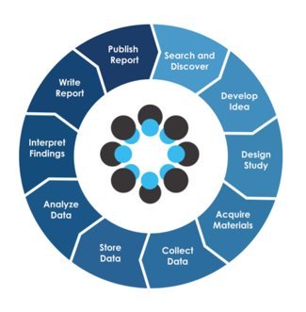
What do journals require for publication?
Open Science practices
Open Science Framework from Center for Open Science
Notes:
GINGER
Increasingly, journals require their authors to practice some form of open science.
What do you already know about open science?
Check out OSF site – you can review the video on your own and browse the site
article on implementation of OSP in mgmt https://www.tandfonline.com/doi/full/10.1080/1359432X.2023.2206571?scroll=top&needAccess=true&role=tab
Give a research topic and look through the available projects together
https://www.aje.com/arc/benefits-of-preprints-for-researchers/
Preprints achieve many of the goals of journal publishing, but within a much shorter time frame. The biggest benefits fall into 3 areas: credit, feedback, and visibility.
A preprint is a full draft research paper that is shared publicly before it has been peer reviewed. Most preprints are given a digital object identifier (DOI) so they can be cited in other research papers.
A preprint is a full draft of a research paper that is shared publicly before it has been peer reviewed.
Preregistration
Project execution
Preprint
Publish
Basic problem for you – you may never get published; higher level problem is the paper is published and then retracted
Learn a programming language instead of SPSS, code more universal and can apply to other analyses makes it easier for you in end

Slide 5
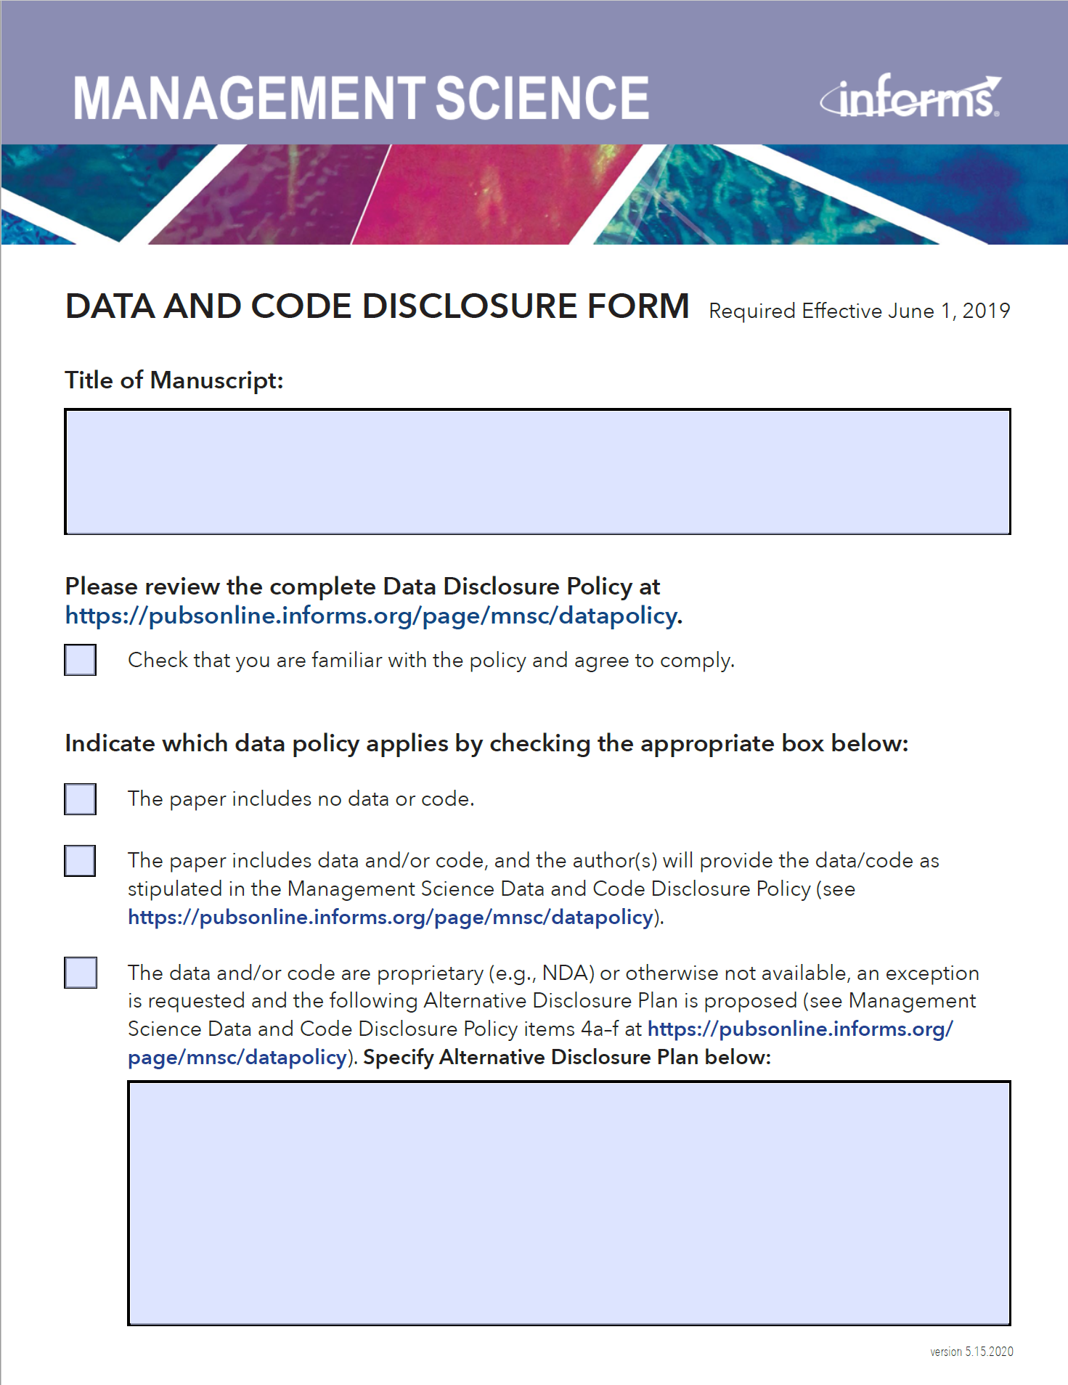
What do journals require for publication?
Changing landscape of academic publication requirements
SAGE Publications
Journal of Personality and Social Psychology (2021)
AMA Journals
Journal of Marketing (2023)
Notes:
GINGER
https://aom.org/research/journals/perspectives
https://mc.manuscriptcentral.com/amp
Why should I practice Open Science?
Science. 2015 June 26; 348(6242): 1422–1425. doi:10.1126/science.aab2374 -- Changing landscape of the academic reward system: Traditional academic "publication requirements (whether actual or perceived) failed to encourage transparent, open, and reproducible science (2, 4, 8, 9). For example, in a transparent science, both null results and statistically significant results are made available and help others more accurately assess the evidence base for a phenomenon. However, in the traditional academic landscape, null results were published less frequently than statistically significant results (10) and are, therefore, more likely inaccessible."
Journals are starting to implement OS requirements, we are in a time when the requirements are always changing and moving twd more OS
Citation of datasets in reference list
Expect skepticism in reaction to your work, think about how to anticipate this; ppl will try to recalculate what you did, try different inclusion data (investigate how different subsets of data affect the results. For example, they could analyze a dataset with different subsets of participants or exclude certain outliers to understand the impact on the findings)
--> you may have submitted last year, and now they have a new policy you must adhere to
https://retractionwatch.com/
https://www.science.org/content/article/what-massive-database-retracted-papers-reveals-about-science-publishing-s-death-penalty
https://retractionwatch.com/2018/11/28/psychology-journal-to-retract-study-claiming-that-people-fear-contagion-less-in-the-dark/#more-79412

Slide 6
Transparency and Openness Promotion (TOP)
TOP Guidelines
TOP Factor
AEA
Notes:
https://www.cos.io/initiatives/top-guidelines ; https://www.cos.io/about/news/new-measure-rates-quality-research-journals-policies-promote-transparency-and-reproducibility
"an alternative to journal impact factor (JIF) to evaluate qualities of journals. TOP Factor assesses journal policies for the degree to which they promote core scholarly norms of transparency and reproducibility. TOP Factor provides a first step toward evaluating journals based on their quality of process and implementation of scholarly values. This alternative to JIF may reduce the dysfunctional incentives for journals to publish exciting results whatever their credibility."
The hope is... "Journal policies can be evaluated based on the degree to which they comply with the TOP Guidelines. This TOP Factor is a metric that reports the steps that a journal is taking to implement open science practices, practices that are based on the core principles of the scientific community. It is an alternative way to assess journal qualities, and is an improvement over traditional metrics that measure mean citation rates. The TOP Factor is transparent (see underlying data and the evaluation rubric) and will be responsive to community feedback."
TOP Factor: click on the data transparency and the analysis code transparency and see that AEA is highly ranked.

Slide 7
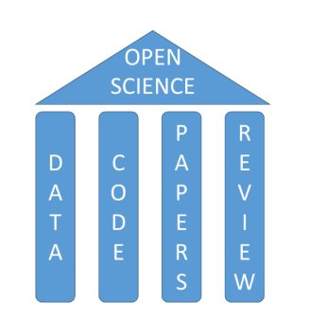
What is Open Science?
A collection of practices that make the content and process of producing evidence and claims transparent and accessible to others.
Concepts: openness, transparency, rigor, reproducibility, replicability, and accumulation of knowledge
Notes:
From: Seven Easy Steps to Open Science Sophia Crüwell, Johnny van Doorn, Alexander Etz, Matthew C. Makel, Hannah Moshontz, Jesse C. Niebaum, Amy Orben, Sam Parsons, and Michael Schulte-Mecklenbeck
Zeitschrift für Psychologie 2019 227:4, 237-248
A collection of practices that make the content and process of producing evidence and claims transparent and accessible to others
“Open science” is an umbrella term used to refer to the concepts of openness, transparency, rigor, reproducibility, replicability, and accumulation of knowledge, all of which are considered fundamental features of the scientific endeavor.
It encompasses many different but often related aspects impacting the entire research lifecycle, including four major pillars: open data, code, papers, and review [From "The Open Science Training Handbook" https://book.fosteropenscience.eu/ : Open Science is the movement to help make the results of scholarly research more accessible, including code, data, and research papers.]
Research transparency and accessibility are key to evaluating the credibility of both statistical evidence and scientific claims. Credibility rests in part on its reproducibility (evidence/data/code) and replicability (results/sci claims).
Reproducibility, which asks whether a study that is conducted can be duplicated, whether that means doing a study all over again or re-running the analyses on the same data. It asks the question—can we do this study again? Replicability has to do with the outcomes of research. If you see a study that’s published and you then run a study to replicate it, does this new study produce the same result? That’s what replicability is—does an effect replicate?
We want to have credible evidence and credible results, so we want our research to be transparent and accessible.
Masuzzo P, Martens L. 2017. Do you speak open science? Resources and tips to learn the language. PeerJ Preprints 5:e2689v1 https://doi.org/10.7287/peerj.preprints.2689v1
Open research data
By open data in science we mean data that are freely available on the public internet permitting any user to download, copy, analyze, re-process, or use these for any other purpose without financial, legal, or technical barriers (other than those inseparable from gaining access to the internet itself).
In the digital era, data are more and more considered to be the main part of a scientific publication (star of the show), while the paper serves the secondary role of describing and disseminating scientific results. This because open data tend to outlive the associated paper. In fact, others (professional researchers as well as interested members from the general public) can conduct re-analyses on these data, and can do so within the context of new questions, leading to new scientific discoveries.
In 2015 Borgman identified four rationales for sharing research data: to reproduce research, to make those data that can be considered public assets, available to the public, to leverage investments in
research, and to advance research and innovation [18].
Building on repr from another angle...
"sharing data enables: verification = the process of checking results for accuracy and to minimize errors and bias in published work,
and analytic reproducibility = the process of checking which data analysis steps were executed for cleaning and analyzing the data at hand—assuring that another person can reproduce the steps." Zeitschrift für Psychologie (2019), 227(4), 237–248
Since science is based on verifiability, not trust, openly sharing the data allows everyone to be informed about every detail in an analysis instead of relying solely on the authors word for it,
"Analytic reproducibility can only be achieved when data are openly available – re-running analyses to identify errors is a key ingredient of a healthy research cycle." Zeitschrift für Psychologie (2019), 227(4), 237–248
Open software code – John was focusing on this in the earlier portion. Reproducibility of research can be improved by increasing transparency of the research process and products. "Open data, materials, and code thus help increase the credibility of the research process, and boost the efficiency of scientific discovery and verifiability" Zeitschrift für Psychologie (2019), 227(4), 237–248
Open access to papers
The gold route refers to OA in the
formal publication system: works are made publicly available at the point of publication (i.e., by the publishers themselves).
The green route refers to authors self-archiving: works are made publicly available by the people who created them. Green OA includes self-archiving of works that have been peer-reviewed, as well as those that have not (e.g., pre-prints). Tennant et al. describe that across academia, only 25% of articles are OA through green or gold routes, despite 79% of journals indexed by SCOPUS endorsing author self-archiving in some format.
Tennant et al. Discuss two specific effects of OA on academic research. First, OA works are used more: within academia, OA works are cited between 36% and 600% more than non-OA works, although opinions differ about the causal nature of this citation advantage. Outside of academia, OA works are given more coverage by journalists and discussed more in nonscientific settings (e.g., on social media). Second, OA works facilitate meta-research because they enable the use of automated text- and data-mining tools. Such options support meta-researchers in investigating research findings, which in turn helps us better understand what existing research can (and cannot) tell us. Tennant, J. P., Waldner, F., Jacques, D. C., Masuzzo, P., Collister, L. B., & Hartgerink, C. H. (2016). The academic, economic and societal impacts of open access: An evidence-based review. F1000Research, 5, 632. https://doi.org/10.12688/f1000research. 8460.3
Open peer-review
considerable number of articles have appeared in various journals that question the process, and
how it is employed [38–41]. Most of these articles have raised issues with the consistency of review,
its definition, ethics, cost, and the speed of the process [9].
Perhaps the first problem lies in the recognition of who peer-review is for. Peer-review is
perhaps the best example of a community-wide way to practice science, and should provide authors
with feedback on their work, preferably also with input for improving it. However, in most cases,
peer-review also helps journal editors decide which submitted manuscripts not to publish.
Furthermore, in most cases, the authors do not know the identity of their reviewers, and, with very
few exceptions, these pre-publication reviews are discarded as soon as articles are published. This
is unfortunate, as a lot of valuable context and insight goes to waste through this discarding. Another
important aspect to consider is that traditional peer-review gives very few incentives (or none at
all) to the reviewers, who are not credited for the considerable amount of time and energy they
spend in performing manuscript reviews.
Another flaw of the current peer-review system seems to be associated with the number of
retractions of articles that journals announce every year. In 2014 and 2015, Springer and IEEE
retracted over 100 published fraudulent articles from several journals [42,43]. Similarly, the
Retraction Watch (http://retractionwatch.com) reports on these issues in other journals. Although it
is not easy to evaluate the amount of published scientific papers containing incorrect conclusions,
the number of retractions may provide information on the problems associated with traditional peer-
review. In 2012, Grieneisen and Zhang surveyed 42 of the largest bibliographic databases for major
scholarly fields and publisher websites [44]. They found that the number of retractions has increased
considerably after 2001. Retractions happen more often in fields such as medicine, life sciences and
chemistry than in fields such as mathematics, physics, engineering and the social sciences.
According to the study, the main cause of retraction is publishing misconduct (such as plagiarism
and authorship or copyright issues), followed by incorrect use of data or incorrect data
interpretation, and research misconduct (e.g., the use of fraudulent or fabricated data).
To address the abovementioned issues, open peer-review models are emerging, in many cases
to complement traditional models. For example, BioMed Central’s GigaScience, all the journals in
BioMed Central’s medical series, and the journal F1000Research all publish reviewer reports, either
as part of the pre-publication review process, or subsequent to publication. This last case is referred
to as open post-publication peer-review: after a first editorial quality check, submitted manuscripts
are published online, peer-review is then carried out openly (reports and names are published
alongside the article), and the authors are the invited to publish a revised version of the article,
together with their response to the reviewers (see Figure 3).
Another form of open review comes from comments on blogs or third party sites, independent
of any formal peer-review that may have already occurred on the article. Amongst other platforms,
PubMed Commons was launched in 2013 as an initiative to enable signed post-publication
commenting on articles indexed by PubMed. It is worth noting that this platform is not related to
any specific journal or publisher, and as such constitutes a forum for public scientific discourse. --> https://ncbiinsights.ncbi.nlm.nih.gov/2018/02/01/pubmed-commons-to-be-discontinued/
Importantly, studies have shown that open peer-review can produce reviews of higher quality,
with better verified claims, and more constructive criticisms, when compared to closed review
[21,45]. Of course, one should keep in mind that open and transparent peer-review does not come
without risks: especially young, early-career researchers might fear that by signing critical and
thorough reviews they could become a target for retaliation at a sensitive point in their career. In
this sense, the traditional closed process provides, in theory, a sort of protection for the reviewer
Science. 2015 June 26; 348(6242): 1422–1425. doi:10.1126/science.aab2374
TOP Guidelines – Transparency and openness promotion
https://docs.google.com/spreadsheets/d/10xFmcrRkg52F-RuPrm_eD75lh62AK-GivQI2vc0r9fk/edit#gid=948504338
LEVEL 3...
Citation: Article is not published until providing appropriate citation for data and materials following journal's author guidelines.
Data transparency: Data must be posted to a trusted repository, and reported analyses will be reproduced independently prior to publication.
Analytic methods (code) transparency: Code must be posted to a trusted repository, and reported analyses will be reproduced independently prior to publication.
Research Materials Transparency: Materials must be posted to a trusted repository, and reported analyses will be reproduced independently prior to publication.
Design and Analysis Transparency: Journal requires and enforces adherence to design transparency standards for review and publication
Preregistration of studies: Journal requires preregistration of studies and provides link and badge in article to meeting requirements.
Preregistration of analysis plans: Journal requires preregistration of studies with analysis plans and provides link and badge in article to meeting requirements.
Replication: Journal uses Registered Reports as a submission option for replication studies with peer review prior to observing the study outcomes.

Slide 8

What is Open Science?
Center for Open Science, transparency standards
Citation
Data transparency
Analytic methods (code) transparency
Research materials transparency
Design and analysis transparency
Preregistration of studies
Preregistration of analysis plans
Replication
Notes:
GINGER
“Open science” is an umbrella term used to refer to the concepts of openness, transparency, rigor, reproducibility, replicability, and accumulation of knowledge, all of which are considered fundamental features of the scientific endeavor.
It encompasses many different but often related aspects impacting the entire research lifecycle, including four major pillars: open data, code, papers, and review [From "The Open Science Training Handbook" https://book.fosteropenscience.eu/ : Open Science is the movement to help make the results of scholarly research more accessible, including code, data, and research papers.]
Research transparency and accessibility are key to evaluating the credibility of both statistical evidence and scientific claims. Credibility rests in part on its reproducibility (evidence/data/code) and replicability (results/sci claims).
From "The Open Science Training Handbook" https://book.fosteropenscience.eu/ : Open Science is the movement to help make the results of scholarly research more accessible, including code, data, and research papers.
It encompasses many different but often related aspects impacting the entire research lifecycle, including open publishing, open data, open source software, open notebook science, open peer review, open dissemination, and open materials (see glossary for definitions).
Masuzzo P, Martens L. 2017. Do you speak open science? Resources and tips to learn the language. PeerJ Preprints 5:e2689v1 https://doi.org/10.7287/peerj.preprints.2689v1
Open research data
Open software code
Open access to papers
Open peer-review
Science. 2015 June 26; 348(6242): 1422–1425. doi:10.1126/science.aab2374
TOP Guidelines – Transparency and openness promotion
https://docs.google.com/spreadsheets/d/10xFmcrRkg52F-RuPrm_eD75lh62AK-GivQI2vc0r9fk/edit#gid=948504338
LEVEL 3...
Citation: Article is not published until providing appropriate citation for data and materials following journal's author guidelines.
Data transparency: Data must be posted to a trusted repository, and reported analyses will be reproduced independently prior to publication.
Analytic methods (code) transparency: Code must be posted to a trusted repository, and reported analyses will be reproduced independently prior to publication.
Research Materials Transparency: Materials must be posted to a trusted repository, and reported analyses will be reproduced independently prior to publication.
Design and Analysis Transparency: Journal requires and enforces adherence to design transparency standards for review and publication
Preregistration of studies: Journal requires preregistration of studies and provides link and badge in article to meeting requirements.
Preregistration of analysis plans: Journal requires preregistration of studies with analysis plans and provides link and badge in article to meeting requirements.
Replication: Journal uses Registered Reports as a submission option for replication studies with peer review prior to observing the study outcomes.

Slide 9
Why Open Science?
Principles of inclusion, fairness, equity, and sharing
Reduce inequities in access to knowledge
Accelerate scientific progress and discoveries
Increase rigor, accountability, and reproducibility
Notes:
Inspired from the replicability crisis (AKA replication or reproducibility crisis) that hit the sciences around 2010
Masuzzo P, Martens L. 2017. Do you speak open science? Resources and tips to learn the language. PeerJ Preprints 5:e2689v1 https://doi.org/10.7287/peerj.preprints.2689v1
Science. 2015 June 26; 348(6242): 1422–1425. doi:10.1126/science.aab2374
"The Open Science Training Handbook" https://book.fosteropenscience.eu/
principles of inclusion, fairness, equity, and sharing: and ultimately seeks to change the way research is done, who is involved and how it is valued. It aims to make research more open to participation, review/refutation, improvement and (re)use for the world to benefit.
Reduce inequities in access and knowledge
e.g Make it easier to access data and information without having to pay high fees for journal access
Accelerate sci prog and discoveries:
knowledge creation is more efficient via collab and strengthened through critique --> harness network effects (pragmatic school)
Societal engagement is necessary for societal impact, invite public to collab via citizen sci and make scholarship more understandable in lay terms (public school)
efficient research requires readily available platforms, tools and services for dissemination and collaboration (infrastructure school)
Increase rigor, accountability, and reproducibility
https://doi.org/10.7287/peerj.preprints.2689v1 , Several studies have furthermore reported that scientific papers accompanied by publicly available data are on average cited more often [19,20], and are moreover characterized by fewer statistical errors and a greater degree of robustness [21].

Slide 10
How do I Practice Open Science?
Think ahead!
Reproducibility
Reduce collection of identifiable info
IRB language in sections:
Provisions to Protect Participant Privacy and Data Confidentiality
Long-term Data and Specimen Storage and Sharing
Use a data repository
Some journals require deposit in a specific repository
AEA
Notes:
GINGER
Data repository: some journals have their own requirements of a specific repo and other journals may provide a list of acceptable repositories
Think ahead: in addition to what John has highlighted re: reproducibility...
There are guides available to researchers on what to consider. I can send the ICPSR and UCL guides.
Reduce collection of identifiable information. When you post data, you need to remove identifiable information. To reduce data cleaning, think of creative ways to get the information you need without collecting identifiable information. The behavioral lab will help keep things anonymous, serving as a middle-person. We use Sona ID instead of names or emails and we can contact a raffle winner, for example so you do not have to collect contact information.
• IRB protocol (reminder that you should always go to the website when starting a new protocol b/c IRB updates their templates often):
Provisions to Protect Participant Privacy and Data Confidentiality
Where and how will you store data/specimens? How long will you store the data or specimens? What will happen to the data/specimens at the end of your study? (Note: Under NU policy, you must keep research data a minimum of 3 years after the completion of the study. However, there are circumstances when other time periods may apply. You must retain consent forms that contain HIPAA authorizations must be retained for at least 6 years after completion of the study.)
For detailed guidance on good research data security practices, please see NU IT's website at https://www.it.northwestern.edu/security/research.html.
If you will be collecting research data while outside the United States, please see NU IT's tips on data security when traveling: https://www.it.northwestern.edu/security/travel.html
Long-term Data and Specimen Storage and Sharing
If you plan to store data/specimens and share them long-term for future research, explain your plan for storing and sharing the data. If you plan to place your data in a data repository, explain which repository/database and why.
Explain whether you will include identifiers with the data/specimens when you share them.

Slide 11
How do I Practice Open Science?
Data Files
Syntax Files
Output Files
Codebook or Data Dictionary
Documentation
README File
Data Backup
Anonymized or De-Identified Data
Notes:
The key to reproducibility is clear documentation.
Data Files: These contain the raw data you collected or obtained for your study. You should save the original data files in a format that SPSS can read, such as .sav (SPSS data file), .csv (comma-separated values), or Excel format. This ensures that others can access and verify your data.
R - Save the original raw data files in a format that R can read, such as .csv, .txt, or .xlsx. This ensures that others can access and verify the data you used in your analysis.
Syntax Files: SPSS syntax files (.sps) contain the commands and instructions you used to perform data cleaning, transformation, and analysis. By saving your syntax files, you provide a clear record of the steps you took to process the data and generate results. This is crucial for replication.
Output Files: SPSS output files (.spv or .spo) contain the results of your analyses, including tables, charts, and statistical tests. Saving these files allows others to review your results and verify your findings. Include both tables and graphical representations.
Codebook or Data Dictionary: A codebook is a document that provides detailed information about the variables in your dataset, including their names, labels, scales, and any recoding or coding procedures you applied. This helps others understand your data and analysis choices.
Documentation: Create a separate document that explains the research design, methodology, data collection process, and any specific decisions you made during the analysis. This documentation can help other researchers understand your study and replicate your work.
README File: Include a README file that provides a brief overview of the project, describes the purpose of each file, and provides instructions on how to replicate your analysis. This is particularly useful if someone else needs to work with your files in the future.
Data Backup: Make sure to keep backup copies of all your files, either in cloud storage or on physical media. This ensures that your data and analysis are preserved in case of any unexpected issues or data loss.
Anonymized or De-Identified Data: If your data contains sensitive or private information, make sure to create and save a version of the dataset that has been properly anonymized or de-identified to protect participants' privacy.
By saving these files, you provide a comprehensive and transparent record of your research process, making it easier for others to understand, verify, and replicate your work. This is a fundamental practice in promoting transparency and scientific integrity in research.

Slide 12
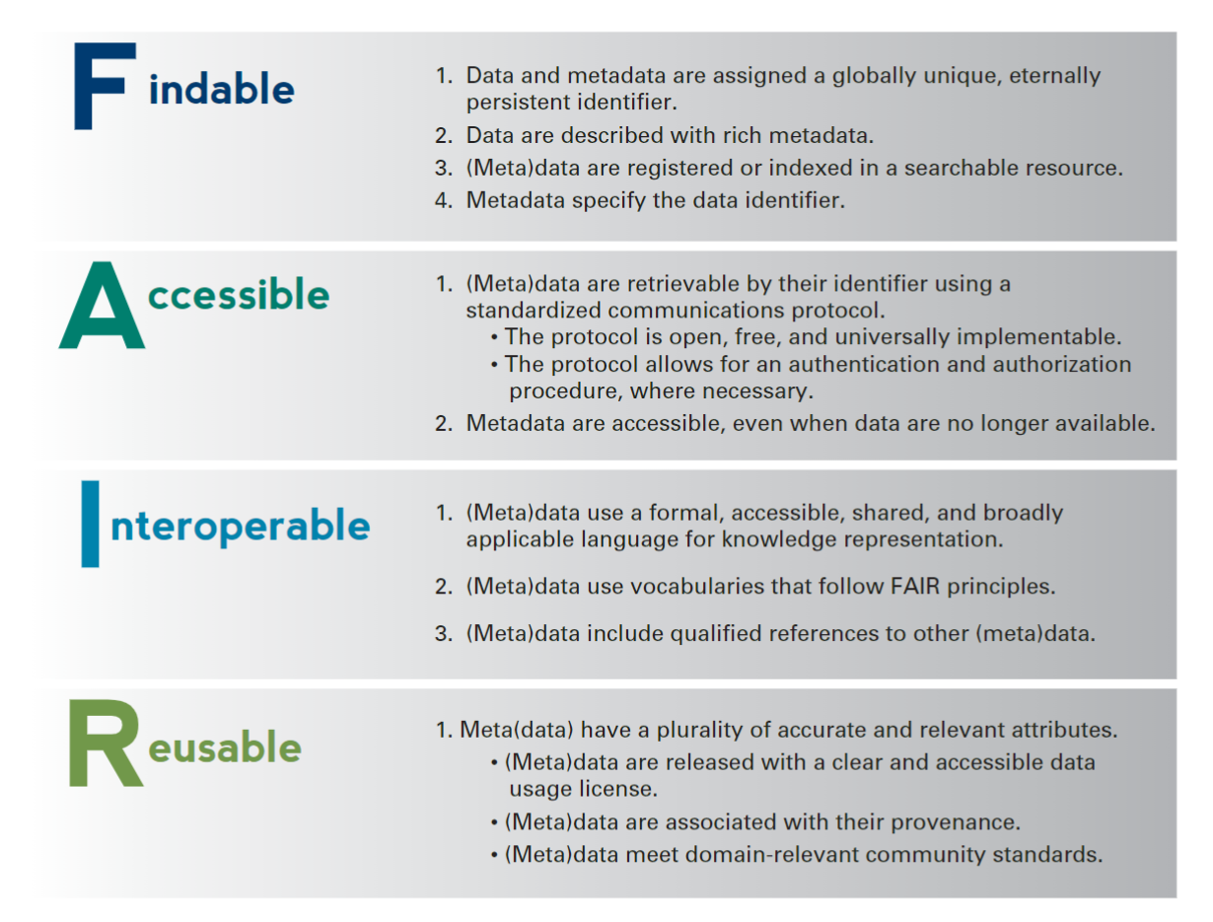
Plan ahead: Archive and preserve data
Notes:
Metadata = description and context of the data
From ICPSR reference https://www.icpsr.umich.edu/web/pages/deposit/guide/
https://nuwildcat-my.sharepoint.com/personal/glj8018_ads_northwestern_edu/_layouts/15/onedrive.aspx?id=%2Fpersonal%2Fglj8018%5Fads%5Fnorthwestern%5Fedu%2FDocuments%2FBehavioral%20Lab%2FLab%20Operations%2FOpen%20science%20and%20data%20repository%2FICPSR%20dataprep%20guide%2Epdf&parent=%2Fpersonal%2Fglj8018%5Fads%5Fnorthwestern%5Fedu%2FDocuments%2FBehavioral%20Lab%2FLab%20Operations%2FOpen%20science%20and%20data%20repository

Slide 13
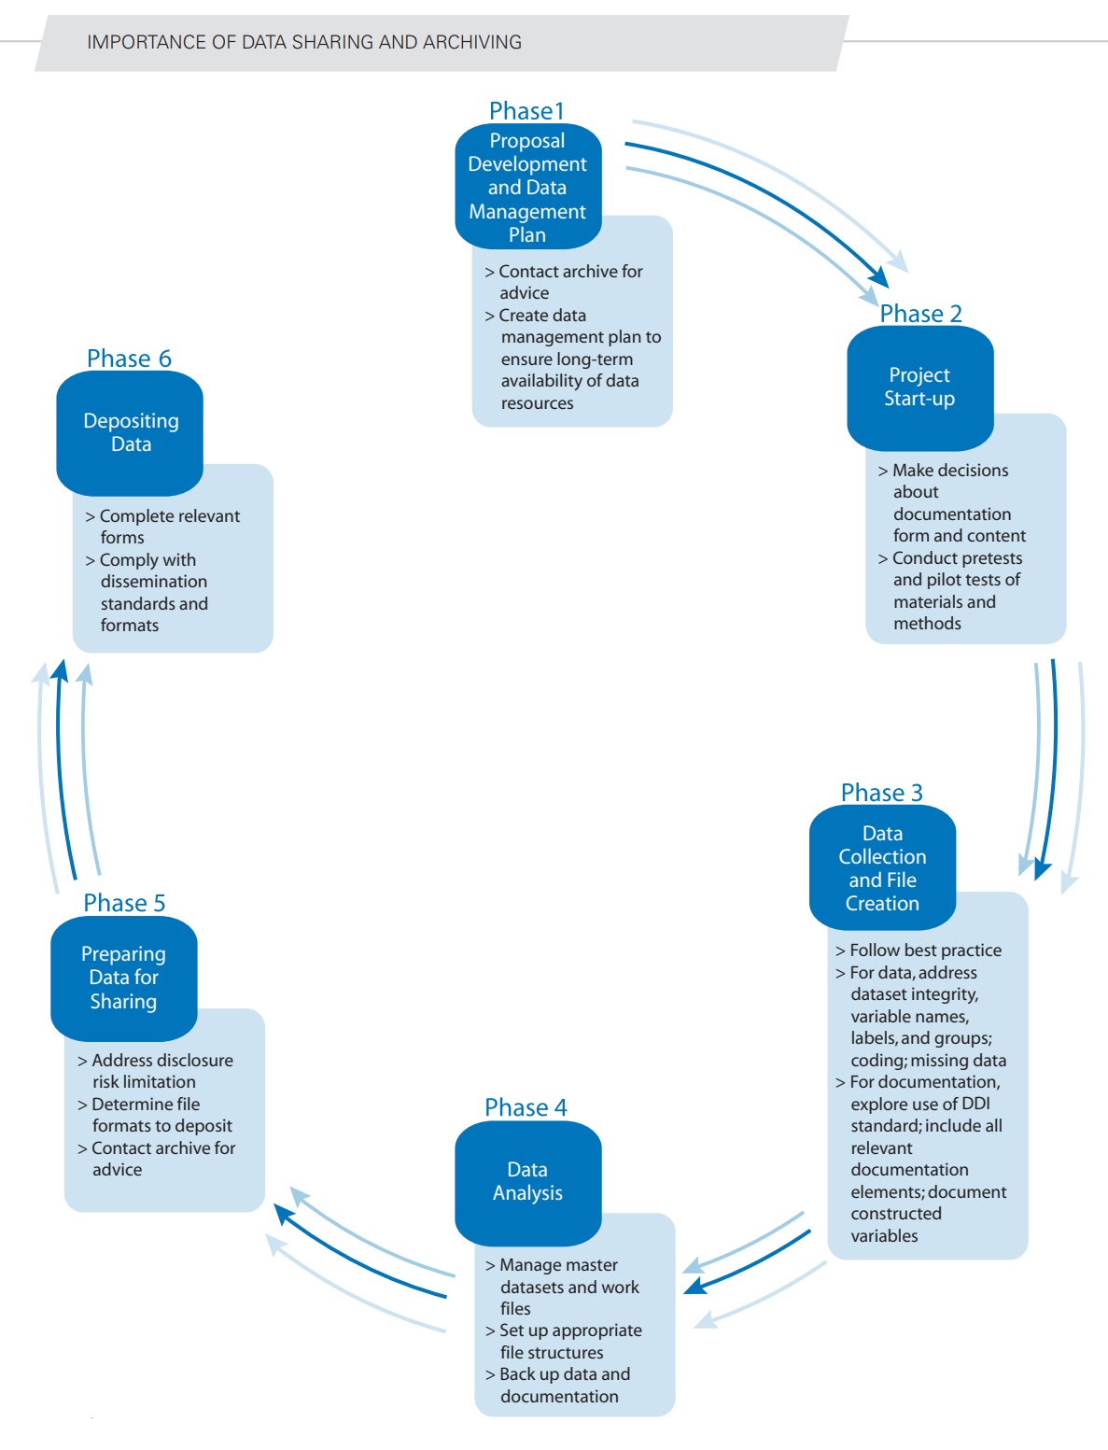
Notes:
https://www.icpsr.umich.edu/files/deposit/dataprep.pdf

Slide 14
Demonstration
Notes:
Discussion to get started
What platforms do you use for deployment?
What software do you use for statistical analysis? For data cleaning?
What platforms do you use to gather online survey data?
Tell me some things you normally have to do to your raw survey data before it is ready to analyze.

Slide 15
Recall Points of Emphasis
Automate whenever possible
Test liberally
Keep good, long-term records
Best to manipulate, analyze data with code!
Always preserve your original data!
Notes:
These are ideas that we emphasized in earlier sessions. The three pillars of doing work now that you will be able to reproduce more easily in the future.
<CLICK>
And we argue there are at least a

Slide 16
To Use The Demonstration Program (R)
KLC details:
https://www.kellogg.northwestern.edu/research-support/computing/kellogg-linux-cluster
You will need a Qualtrics account, prior survey activity.
Change program to search for your survey title.
Run a one-time step to add your Qualtrics credentials to .Renviron.
Found under Account Settings / Qualtrics IDs: API Token, Organization ID, Datacenter ID

Slide 17
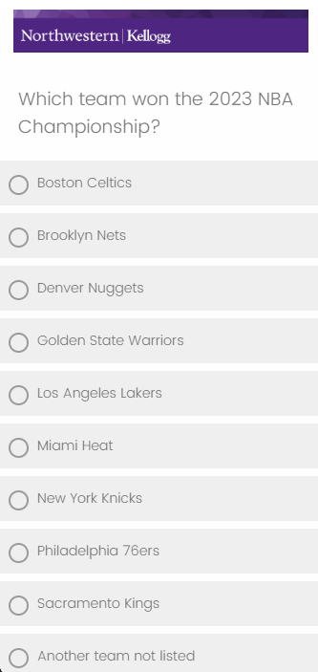
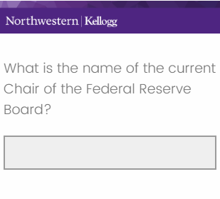
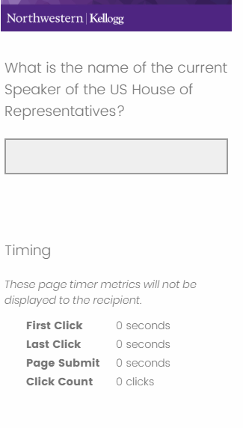
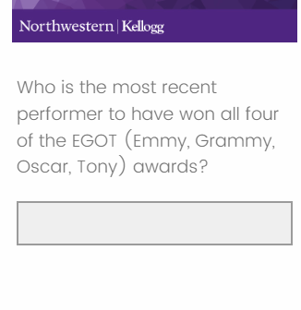
Survey Questions for Demo
Notes:
These are some of the questions that we asked in the survey that we will use in the demo. They essentially test knowledge of some current events or trivia-type questions. We figured while many people will immediately know the answers to some questions, most people would not be able to answer all of them without help.
Note: we measured response time for all these questions. Respondents were asked not to look up answers using outside sources, and the response times would give us some suggestion of whether they did this or not.

Slide 18
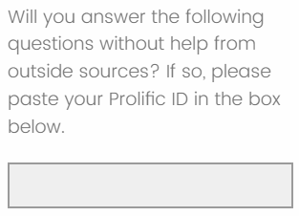
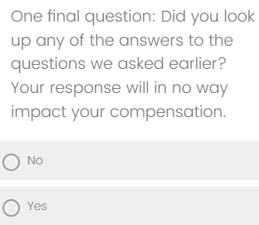
Survey Questions – No Outside Help
Notes:
In addition, we asked a few other questions to help us understand

Slide 19
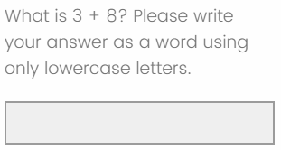
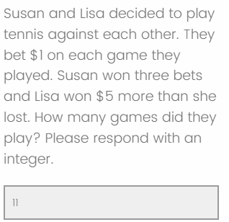
Attention and Comprehension Checks
Notes:
In addition, we asked a few other questions to help us understand

Slide 20
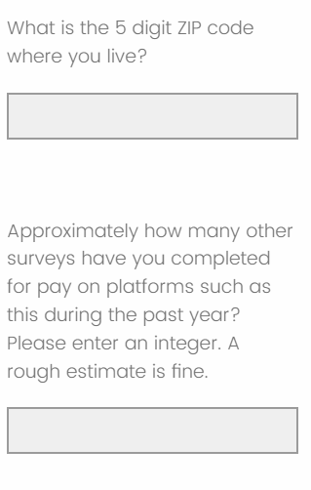
Respondent Attributes
Notes:
In addition, we asked a few other questions to help us understand

Slide 21
Go to KLC

Slide 22
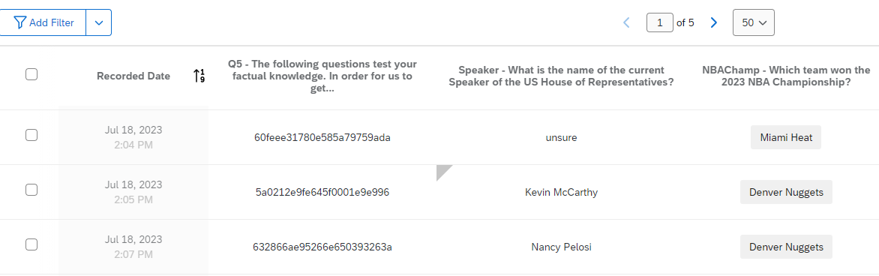


Beware: Response Editing Feature!
Notes:
Fortunately for you, this is a management, and we have some commonsense ideas for how to make collaborations – including with your future self – work better.
Some of those concepts that are most relevant to your scientific computing projects include:
Keeping records of what you do that will be easy to use,
Being very economical with your solutions. The #1 easiest way to fail at replicating your results is to present yourself with 2 different ways to solve the same problem.
And recognize that humans make mistakes. We forget things. We sometimes make poor decisions. So more generally, give your future self fewer opportunities to make mistakes.

